Slide 1
Recommending Books to Avid Readers
Amanda Spencer, Nithin Sriram, Jichen Zhang

Slide 2
Agenda
What does our application do?
Website Design (Implementation)
Dataset
Live demonstration/Video demonstration
Evaluation
Conclusion

Slide 3
Application
Goal:
Create a web-based application that recommends books based on a set of criteria that the user inputs and allows users to place books that they’d like to read in their wishlist idk if this is done in the application yet.
Functionalities:
Users can login into our application with unique usernames and passwords
Search for books based on inputted author, genre, publication year, and ratings criteria.
Add recommended books to wishlist page for future readings
Domain:
Books
Importance of Having a Database:
Our dataset is highly relational and the size of our dataset is enormous (several Gigs of text)
MySQL
Notes:
With so many books and so little time, the avid bookworm will value our application’s recommendations.
Our users would be able to search for books based on genre, author, number of pages, rating, and even publication year. Upon clicking on a recommended book, they would be able to see more information about the book including the publication date, the genre distribution, a picture of the book cover, and other similar books. The user would then have the option to add the book to their wishlist. At any time, the user will have the ability to add or remove books from their wishlist as well as modify their name, username, and password. It is essential to have a database in this domain application because the size of our dataset is enormous (Gigs of plain text) and highly relational. Entities like books, users, genres, and authors can make the task of querying much easier. It would be virtually impossible to do this project without a database.
The DBMS we would use for this project is MySQL because it suits the needs of our project well and we are quite familiar with the syntax. We aren’t doing any complicated data analysis, our dataset is quite large, and MySQL can handle querying large amounts of information.

Slide 4
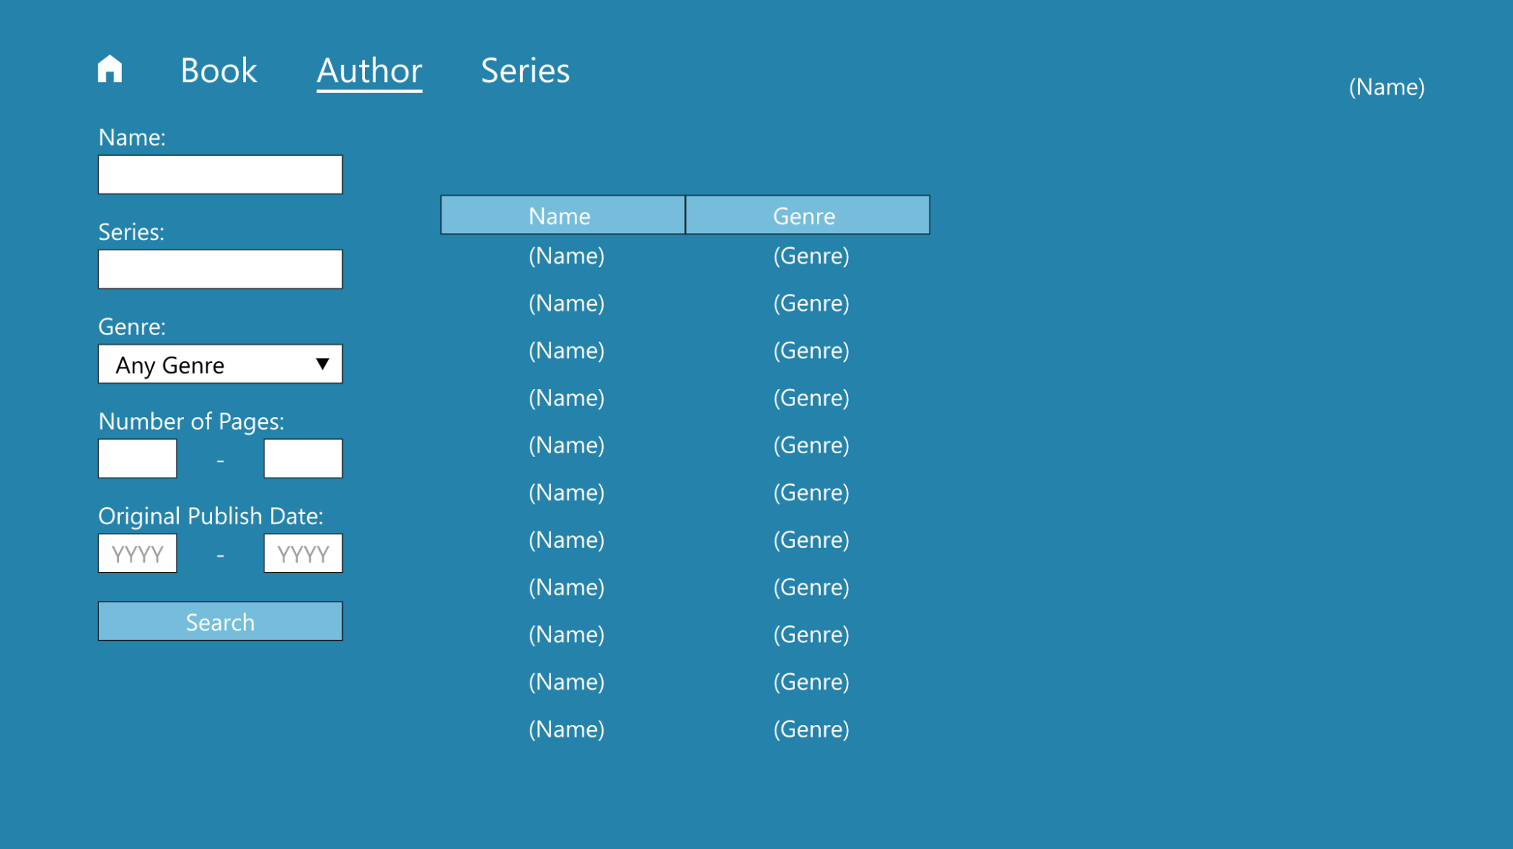
Implementation

Slide 5
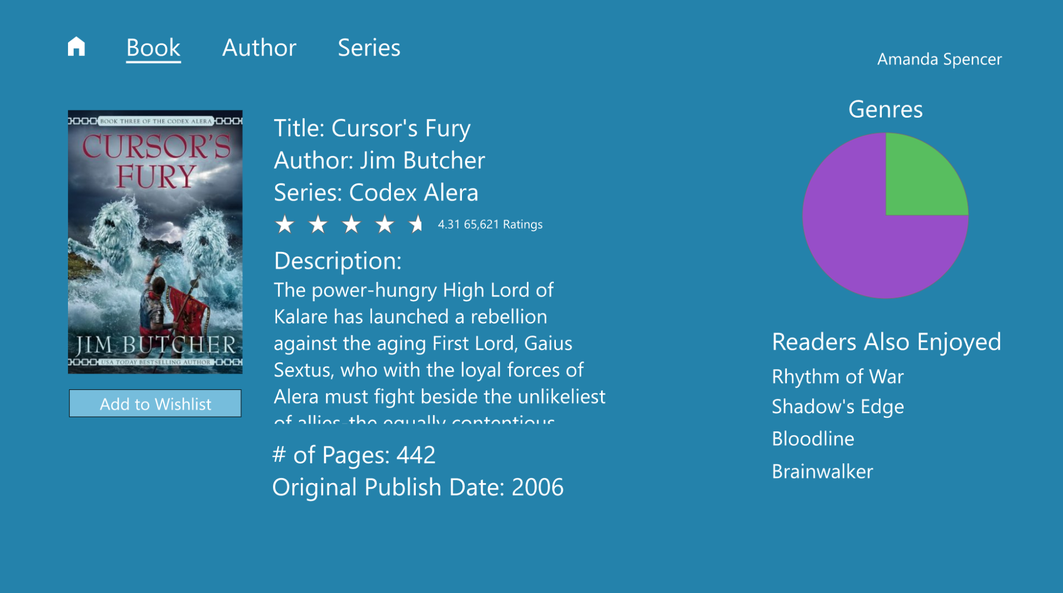
Implementation
Notes:
We would be using JavaScript and React.js to create a responsive web application that connects with the database. We will use BootStrap to make it easy to implement and also have an aesthetic-looking UI. This will allow the user to select what criteria they wish to choose to search for book recommendations by and will query the database and give recommendations based on that. We are still considering whether or not to host this webpage (We are hosting the webpage right?).

Slide 6
Dataset
Detailed Book Graph Dataset
Goodreads - UC San Diego
2 Million? books/rows
20 fields/columns
(Not sure what else to put here)
Notes:
The datasets were collected at UC San Diego in 2017 from public information on goodreads.com. It was used in two research papers: one written by Mengting Wan and Julian McAuley and one written by Mengting Wan, Rishabh Misra, Ndapa Nakashole, and Julian McAuleyand. Goodreads is a commonly used website/application that is used to find information about books, authors, and book series. With an account, a user can keep track of books they’ve read and books they would like to read as well as rate books that they have read. As such, it falls within our domain. Because these particular datasets were collected at an accredited university and used in published papers, we were fairly confident that the datasets would be relatively clean. A quick survey of the data confirmed it.
We also chose these datasets because they conform to project requirements. The “Detailed Book Graph” dataset contains over 2 million books (rows), which far exceeds the minimum of 10,000 records, and each book has over 20 fields (columns). One of those fields is ‘similar_books’ which can be used in a recursive relationship to recommend other books. In addition to the main dataset, they also have datasets covering authors, series, and genres. Using those datasets in conjunction with the main one allows more than the required 4 entity sets and 3 relationship sets. With the addition of a user entity, for which inserting, deleting, and modifying data will be supported, all of the requirements can be fulfilled.

Slide 7
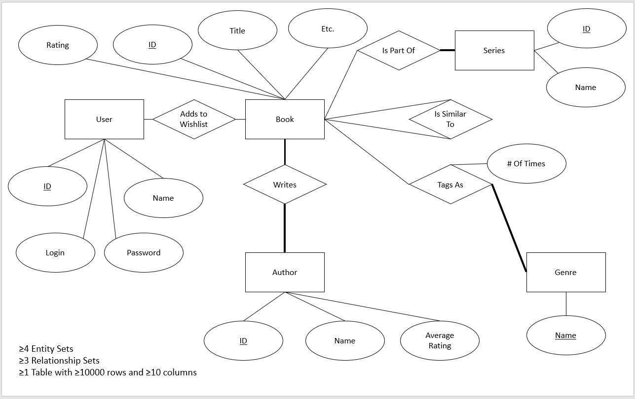
ER Diagram

Slide 8
Application Demonstration

Slide 9
Evaluation
It was challenging to understand the dataset in detail simply because of how many fields were populated and the character length of the arrays for certain attributes
It was interesting to choose a project where we were all able to quickly visualize the goal of our application because as avid readers we have all been through the struggle of figuring out which book to read next.
(Anything else I may be missing?)

Slide 10
Conclusion
If we were to continue to work and improve the capability of this application, we would include a feature that would allow users to find out which nearby libraries have the books in their wishlist in stock/links to websites with e-book versions (this seems like a final thought to the project - is there another bullet point above that would fit?)

